Slide 1

BRAIN WAVE DETECTION SYSTEM
Project Mentor: Asst. Prof. Abhishek Tiwari
(ECE Dept.)
Group Members:
Vishal Kumar (1702731168)
Salman Khan (1702731121)
Umar Farooq (1702731155)
Ajay Kumar Garg Engineering College, Ghaziabad

Slide 2
PROBLEM STATEMENT
A variety of studies have shown approx. 20% road accident are due to drowsiness.
Nearly 1.3 million/year , 3287 per day, 2 people every min
The main Aim is to develop a Brain Wave detection system
Drowsiness causes more accident then drunk driving case.
Used Alcohol sensor to avoid the vehicle from starting.
An automated system for safety of driver.

Slide 3
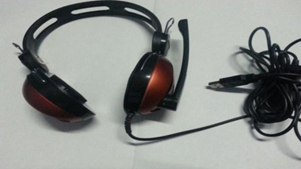
INTRODUCTION
INTRODUCTION
Brain Wave Detection System
A Smart Device based on EEG Signal (Electro Encephalography)
Wavelet method of identifying drowsiness
Detect the Alcohol level
Controlling automatic Breaking System also
An Accident Prevention vehicle safety device
Brain Wave Detection Model

Slide 4

FLOW DIAGRAM
START
INPUT LIVE FEED
ALCOHOL
DETECT
PROCESS
YES
DETECT DROWSINESS
IF DRUNK
NO
NO
START VEHICLE
IF DROWSY
YES
MOTER
CONTROL
DRIVER
SLEPT
BUZZER
ON
YES
STOP
Fig 1 – flow diagram
Notes:
Start with Our project works as shown in the flow diagram.

Slide 5
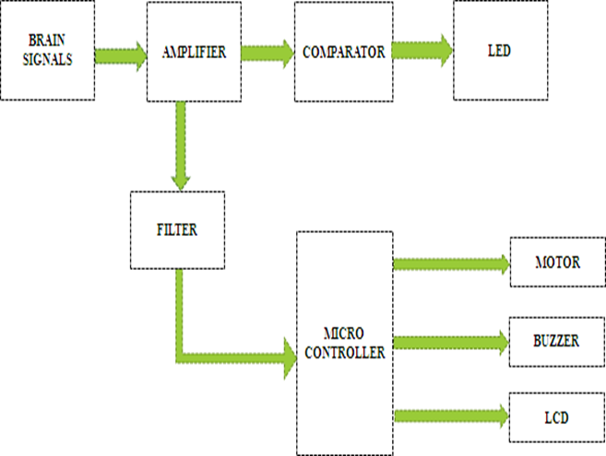

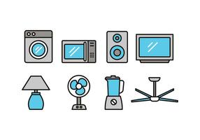
PROJECT ARCHITECTURE
BLOCK DIAGRAM
POWER
SUPPLY
LCD DISPLAY
ALCOHOL SENSER
MICRO CONTROLLER
EYEBLINK SENSOR
BUZZER
TILT SENSOR
MOTOR DRIVER
DC MOTOR
5
Notes:
Explain a little about modes

Slide 6
COMPONENT DISCRIPTION
The Various Hardware Components are.
MSP430 microcontroller
Brain signal sensing electrode
Alcohol sensor
LCD
Buzzer
Bread board

Slide 7
PROJECT MODULES
There are 2 modules as given below:
MODULE 1
Alcohol Sensor Module
MODULE 2
Extraction of Brain Signal Module
Notes:
Sumit

Slide 8
Module 1- ALCOHOL SENSOR MODULE
POWER
SUPPLY
LCD DISPLAY
Readings from MQ3 sensors, and is given to microcontroller.
Based on the sensor value it will select the mode
It processes the data to be sent through both:
LCD
Motor Driver
Result in automatic breaking system
Micro controller
MOTOR DRIVER
ALCOHOL SENSOR
DC MOTOR
Mode 1: Driver is Sober
Mode 2: Driver is Drunk
Mode 3: Driver was initially sober but get drunk after some time

Slide 9
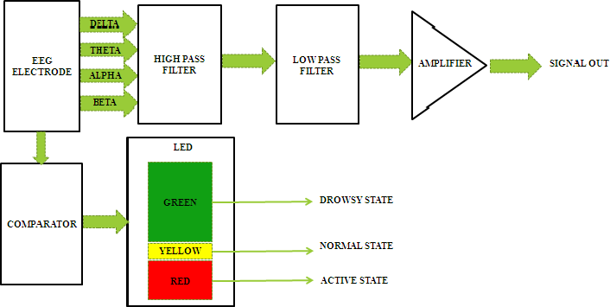
Module 2 – EXTRACTION OF BRAIN SIGNAL MODULE
The Electro Encephalography (EEG) is a record of the electric signals generated from brain activity.
EEG provide important and unique information about sleeping brain.
A pair of electrode is affixed inside the headset or cap which is responsible for brain wave.
Block diagram of
Extraction of
Brain wave signal
STATE OF LED INDICATION
Case 1: ACTIVE STATE
Case 2: NORMAL STATE
Case3: DROWSY STATE

Slide 10
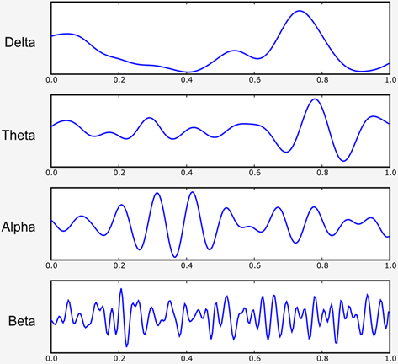
EEG Signal Classification
In Theta range
Driver is in drowsy state
Fig: EEG signal – Classification

Slide 11
SOFTWARE DESCRIPTION :
#include<pic.h>
void delay(int e)
{
while(e--);
}
void lcd_cmd(unsigned char n)
{
RE0=0;
RE1=1;
PORTD=n;
delay(1000);
RE1=0;
}
void lcd_data(unsigned char *p)
{
while(*p!='\0')
{
RE0=1;
RE1=1;
PORTD=*p;
delay(1000);
p++;
RE1=0;
}
}
void main()
{
int a,b,c,count=0;
ADCON1=0x82;
ADCON0=0xc5;
TRISA=0x3f;
TRISE=0x00;
PORTE=0x00;

Slide 12
TRISC=0x00;
PORTC=0x00;
TRISD=0x00;
PORTD=0x00;
CCP1CON=0x0c;
CCP2CON=0x0c;
PR2=128;
TMR2=0;
T2CON=0x04;
CCPR1L=0;
CCPR2L=0;
lcd_cmd(0x01);
lcd_cmd(0x38);
lcd_cmd(0x06);
lcd_cmd(0x0c);
lcd_cmd(0x80);
lcd_data(" DROWSINESS ");
lcd_cmd(0xc0);
lcd_data(" SYSTEM ");
delay(20000);
lcd_cmd(0x01);
while(1)
{
GO=1;
while(GO==1);
a=ADRESL;
b=ADRESH;
b=b*256;
c=a+b;
if(c>0 && c<500)
{
CCPR1L=255;
lcd_cmd(0x80);
lcd_data(" NORMAL ");
}

Slide 13
if(c>500 && c<1023) { lcd_cmd(0x80); lcd_data(“ ABNORMAL “);
if(count==0)
{
for(int j=255;j>=0;j--)
{
CCPR1L=j;
delay(600);
}
count++;
}
}
}
}

Slide 14
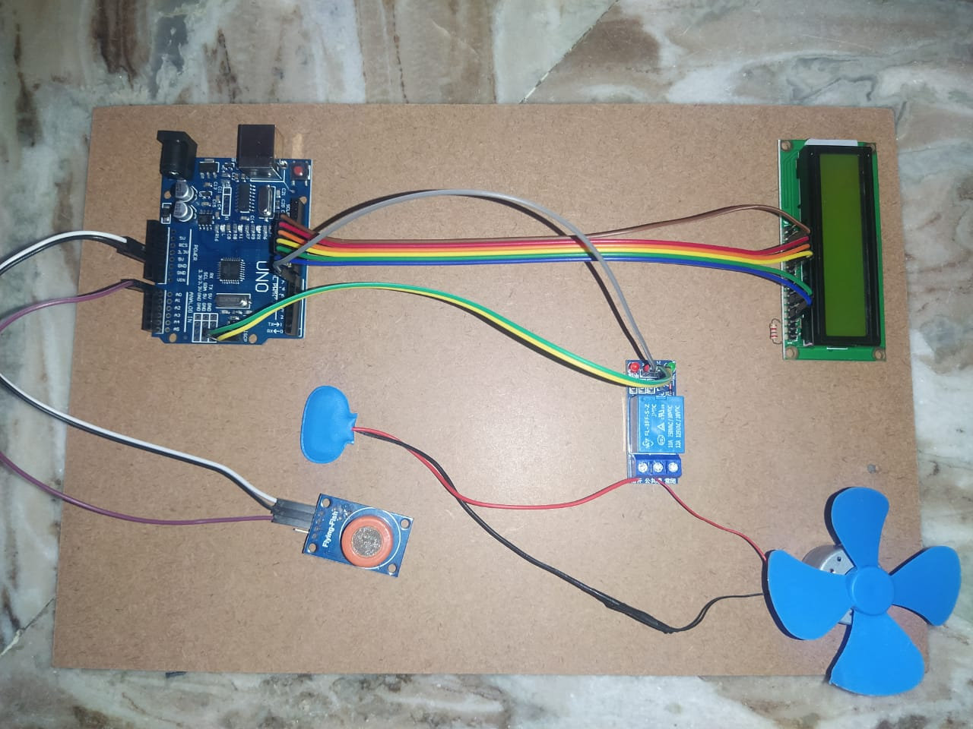

Slide 15
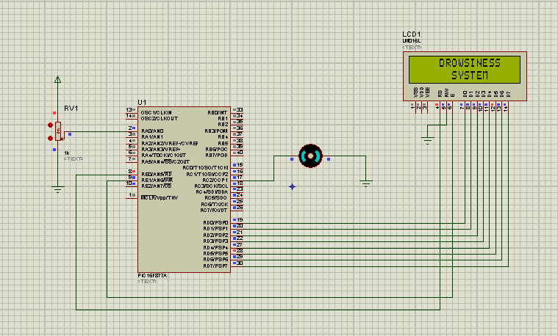
RESULTS :
Figure-2. Simulation output when the driver is in drowsy condition

Slide 16
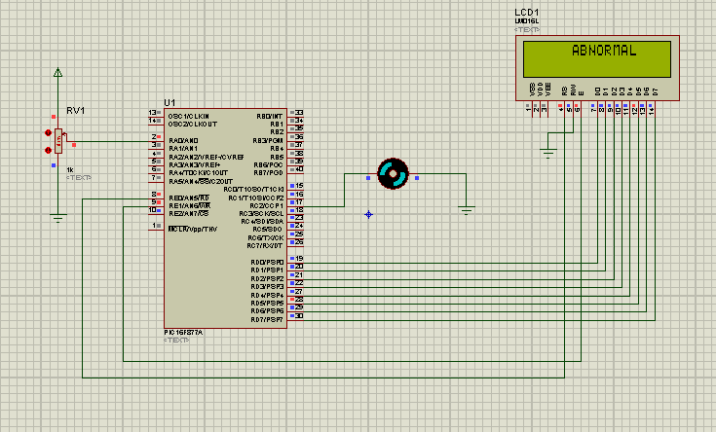
Figure-3. Simulation output when the driver is in abnormal condition.

Slide 17
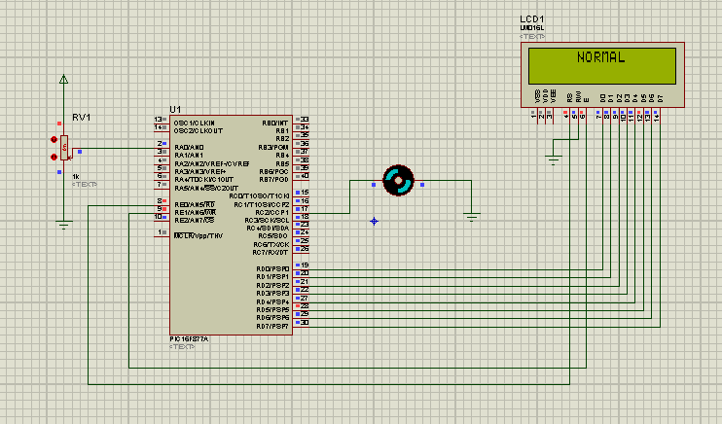
Figure-4. Simulation output when the driver is in normal condition.

Slide 18
MERITS
No need of monitoring cameras on other devices to aimed to driver
Decrease road Accident
Use of Mind Machine Interference (MMI) ,Catch Brain waves and tells you before sleep.
It warns driver in advance
Vehicle Safety Technology.
This Method is Practically Applicable.
Notes:
tushar

Slide 19
APPLICATION
All night drivers – heavy vehicle drivers.
Students – Last night study
Security Guards – as they have late night duties
Cab Drivers – Security Measures/Commercial vehicle / Public transport
Coma patient wake up suddenly.
19

Slide 20
FUTURE SCOPE
There can be a lot of future enhancements associated to this project, which includes:
Driving Recognition Pattern.
Using High Sensitive Sensors.
Automatic Breaking System and Navigating System that change course before collision. And Navigate the Car with less collision
Detect level of Drowsiness
Using IOT for operating entire car system.
Better face detection cameras.

Slide 21
References
Mandalapu Sarada Devi, Monali V. Choudhari, Preeti Bajaj, “Driver Drowsiness Detection Using Skin Color Algorithm and Circular Hough Transform”, IEEE 2011 Fourth International Conference on Emerging Trends in Engineering and Technology, Nov 2011.
Jang Woon Baek, Byung-Gil Han, Kwang-Ju Kim, Yun-Su Chung, Soo-In Lee, “Real-Time Drowsiness Detection Algorithm for Driver State Monitoring Systems”, IEEE 2018 Tenth International Conference on Ubiquitous and Future Networks , July 2018.
Prakash Choudhary, Rahul Sharma, Gautam Singh, Smarjeet Das, “A Survey Paper On Drowsiness Detection & Alarm Systems for Drivers”, IRJET Volume:03 Issue:12, Dec 2016.
Tejasweenimusale, prof B,H. Pansambal, ”Real time driver drowsiness detection system using image processing”, IJREAM, Vol 02, Issue 08, 2016.
Omkar, RevatiBhor, PranjalMahajan, H.V. Kumbhar “Survey on Driver‟s drowsiness detection system”,vol.132,2015.
Christy, Jasmeen Gill, “A Review: Driver drowsiness detection system”, IJCST, Vol.3 Issue 4,jul-aug 2015.
https://www.electronicsforu.com/electronics-projects/anti-sleep-alarm
❖ http://www.123seminarsonly.com/EC/anti-sleep-alarm.html

Slide 22
Thank You

